Slide 1
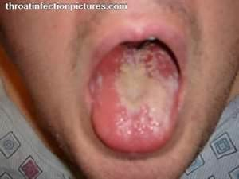
STD’s/STI’S
HIV

Slide 2
Most STD/I’S
Go undiagnosed
Having an STI increases your risk of HIV infection
Have periods of time where the person is symptomless and therefore you can unknowingly transmit them
Half of all STI’s occur in people under the age of 25
One in 4 in cases happen in teenagers
The age group 15-24 has 5 times the normal rate of Chlamydia, 4 times the normal rate of gonorrhea, and 3 times the normal rate of syphilis

Slide 3
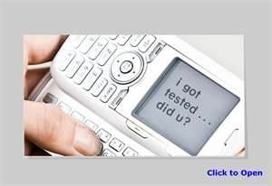
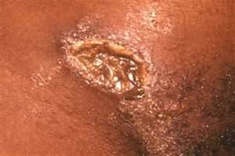
1 in 2
SEXUALLY ACTIVE
Young people
Will get
An STD/I
By the age of
25
MOST
Will not know it

Slide 4
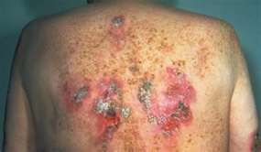
Types of STD/I’s
Human Papillomavirus (HPV)
Chlamydia
Pelvic Inflammatory Disease (PID)
Gonorrhea
Genital Herpes
Syphilis
Hepatitis B
Trichomoniasis /Bacterial Vaginosis
Pubic Lice
Human Immunodeficiency Virus (HIV)

Slide 5
STI Data in Milwaukee

Slide 6
What puts Teens at a higher risk??
More likely to have multiple, sequential, or concurrent sex partners, rather than single long term relationships
More likely to engage in unprotected sexual intercourse
They select partners that are at higher risk
“IF YOU DON’T TAKE RESPONSIBILITY FOR YOUR SEXUAL HEALTH, WHO WILL??

Slide 7
STDI REPORT
USE EITHER OF THESE TWO WEBSITES: cdc.gov or iwannaknow.org
Create a power point answering the following questions about your STI. It should be one slide per question, you may add pictures as long as I approve. No genitalia!
Answer the following questions regarding your STI
What is it?
How common is it?
How do people get it (method(s) of transmission)?
What are the symptoms?
What are the complications if not treated?
How does it affect the pregnant women and or the baby?
What is the treatment?

Slide 8
Categories of STD/I’s
Virus: Smallest known pathogen. No known cure, can only treat the symptoms.
Examples Genital warts, genital herpes, hepatitis, HPV and HIV
Bacteria: Single celled microorganism. Cured by antibiotics.
Examples: Chlamydia, syphilis, gonorrhea, vaginitits.
Other Protozoan/parasites: Single celled organism. Cured by special medicated shampoos, and some oral medications.
Examples: Trichomoniasis, pubic lice, scabies.

Slide 9
HIV/AIDS Pre Test
1. Which statement best describes the relationship between HIV and AIDS?
a. HIV and AIDS are the same thing.
b. HIV can be cured but AIDS cannot be.
c. HIV is the virus that causes AIDS.
d. HIV has no relationship to AIDS.
2. Which of these statements about HIV infection is true?
a. HIV attacks cells of the immune system.
b. HIV can be detected with a blood test.
c. HIV can lead to AIDS if untreated.
d. All of the above

Slide 10
3. Who is most likely to get infected with HIV?
a. People who have unprotected sex.
b. Gay men.
c. People who donate blood.
d. People who get blood transfusions from donors.
4. What do people with HIV look like?
a. They are usually sick and frail.
b. They are usually well-groomed and strong.
c. They are usually like everyone else.
d. They are usually poor and shabby.
5. What is the relationship between sex and alcohol use?
a. Alcohol makes sex better.
b. Alcohol reduces a person’s interest in sex.
c. Alcohol kills germs so condoms aren’t necessary.
d. Alcohol reduces a person’s ability to make good decisions about sex.
j

Slide 11
6. How can the risk of an HIV infection be reduced?
Use a condom for sex every time.
Avoid injection drugs.
Abstain from sex and drugs.
All of the above.
7. Which of the following activities cannot transmit HIV?
everyday activities like talking, hugging, going to a movie
having unprotected sex with a regular partner
sharing needles to shoot drugs
All these activities are risky.
8. Which of these statements about HIV infection is true?
a. With medication, a person can live a fairly normal life.
b. Death occurs within months of HIV infection.
c. Medications can eliminate HIV from the body.
d. The HIV infection quickly spreads to the brain.

Slide 12
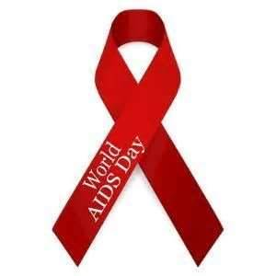
9. Which of these statements about women with HIV is true? a. They become sterile and cannot have children. b. They have difficulty becoming pregnant. c. They always pass HIV to their babies. d. They can have a baby that does not have an HIV infection. 10. What does the HIV test look for? a. the virus itself b. antibodies to the virus c. cells in the immune system d. signs that the immune system is very weak

Slide 13
HIV/AIDS STATS
In 2009 alone, there were an estimated 2,078 new cases of HIV infection in 13- to 19-year-olds and 6,314 new cases in 20- to 24-year-olds.
In 2007, HIV was the ninth leading cause of death for African-Americans of all ages and the third leading cause for African-American men and women between the ages of 35 and 44.
The Centers for Disease Control (CDC) report that 20 percent of reported new HIV infections in 2009 are in people under 25.
In 2009 in the US, 90 percent of the HIV infections in 13- to 19-year-olds were the result of sexual intercourse.
In the US in 2009 almost one-quarter of new HIV cases in 13- to 19-year-olds were female. In young people between the ages of 20 and 24, females made up 19 percent of all HIV cases.
were infected..
—Sources: Centers for Disease Control and UNAIDS

Slide 14
In 2009 approximately 35 million people worldwide were living with HIV/AIDS. This is a decrease from 2002, when an estimated 42 million people worldwide were living with HIV/AIDS. More than 70 percent of these people live in Sub-Saharan Africa.
Worldwide, more than 80 percent of all adult HIV infections have resulted from heterosexual intercourse.
Approximately 50,000 new HIV infections occur in the United States each year; about 70 percent among men and 30 percent among women.
Through the end of 2008, approximately 617,000 people have died from AIDS in the US.
Approximately 1,000,000 people were living with HIV infection or AIDS in the US at the end of 2008. Of these an estimated 21 percent did not know they

Slide 15
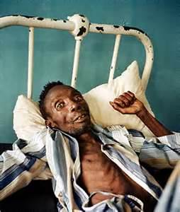
What is HIV?
Human Immunodeficiency Virus
Virus that causes aids
HIV damages the bodies immune system, thus causing
AIDS
People typically die from complications of a secondary infection or disease
How does HIV become AIDS
HIV destroys a certain type of blood cell CD4+T cells

Slide 16
HIV/AIDS Facts
HIV can be transmitted through:
Blood
Semen or Pre-seminal fluid
Vaginal fluid
Breast Milk
HIV can enter through a vein, the lining of the anus or rectum, the lining of the vagina or cervix, the opening of the penis, the mouth or other mucus membrane.
It cannot enter through intact, healthy skin. It is not found in saliva, tears, sweat, urine , feces, vomit or nasal secretions unless blood is present.
Most common ways it is transmitted
Unprotected Sex (anal, oral or vaginal)
Sharing needles
Mother to baby at birth or breast milk

Slide 17
Special Cases
KISSING— Only one case of AIDS has ever been attributed to open-mouth kissing. However, because of the potential for contact with blood during open-mouth kissing, never practice this activity with someone who is infected.
SPITTING or BITING— Although saliva contains a very minor amount of HIV, it also contains a protein that works to destroy the virus. The amount of HIV in saliva is not high enough to make spitting or biting a common risk.
HEALTHCARE WORKERS— Investigations into more than 22,000 patients of 63 HIV-infected doctors and dentists have resulted in only one demonstrated case of HIV transmission.
SHARED UTENSILS— There is an extremely remote chance for HIV transmission, and only if blood is involved, such as from a cut in the mouth.
TEARS and SWEAT— These fluids do not contain enough HIV to cause infection.

Slide 18
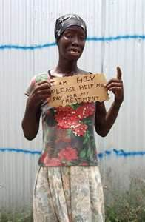
HIV Cannot Be Transmitted Through
Casual contact (social kissing, shaking hands, coughing, sneezing, swimming pools, bathrooms, eating utensils, drinking fountains)

Slide 19
How does HIV cause AIDS?
HIV destroys a certain kind of blood cell—CD4+ (also called T cells or helper cells)—that is crucial to the normal functioning of the human immune system. Reducing the amount of the virus in the body with anti-HIV drugs can slow this destruction of the immune system.
Do new medicines cure AIDS?
No. HIV infection and AIDS are not curable. However, new medications are available which slow the rate at which HIV replicates. Combined with a healthy lifestyle, these medications can postpone or prevent the development of AIDS.
How do I know if I’m infected with HIV?
The only way to determine for sure whether you are infected is to be tested for HIV infection. Most people who are infected with HIV do not have any symptoms at all for many years. Symptoms can appear 10 years or more after infection.

Slide 20
What are the symptoms of HIV infection?
The following symptoms may occur with HIV infection:
rapid weight loss
dry cough
recurring fever or profuse night sweats
profound and unexplained fatigue
swollen lymph glands in the armpits, groin, or neck
diarrhea that lasts for more than a week
white spots or unusual blemishes on the tongue, in the mouth, or in the throat
pneumonia
memory loss, depression and other neurological disorders

Slide 21
How long does it take for HIV to cause AIDS?
Scientists have estimated that about half the people infected with HIV develop AIDS within 10 years after becoming infected. This time varies greatly from person to person and can depend on many factors, including a person’s health care and lifestyle.

Slide 22
How can I tell if I have HIV
Blood test
It takes 3 to 6 months after you are exposed to develop the detectable antibodies that tell if you have HIV
Dr. Office, STD clinics, Family planning services, HIV testing sites
WHO SHOULD BE TESTED
Men who have unprotected sex with other men
People who share needles
People with several sexual partners
People who already have another STI
Infants born to HIV positive mothers
People who are significantly exposed to another person’s blood
and they have open wounds, or exposure to open areas

Slide 23
HIV Statistics

Slide 24
WHERE CAN I GET MORE INFO?
Wisconsin AIDS line: 1-800-334-AIDS
Spanish speaking AIDS line: 1-800-344-7432
Red Cross
AIDS service organizations in Milwaukee
On the Web
Wisconsin AIDS/HIV Program
Centers for Disease Control
National Prevention Information Network

Slide 25
BLOOD LINES DVD

Slide 26
RED LIGHT – GREEN LIGHT ACTIVITY
RED LIGHT = HIGH RISK ACTIVITY
YELLOW LIGHT = MODERATE RISK ACTIVITY
GREEN LIGHT = LOW RISK ACTIVITY

Slide 27
High Risk Behaviors for getting HIV
Anal Intercourse without a condom
Sharing needles for injecting drugs, etc..
Vaginal intercourse without a condom
Anal intercourse with internal ejaculation with a condom
Vaginal intercourse with a condom and internal ejaculation
Sharing needles for tattooing, or piercing
Breast feeding by an infected mother
Unprotected oral sex
Cleaning blood spills with no barrier

Slide 28
Low Risk Behaviors
Blood spills with barriers
Mutual masturbation
Deep wet kissing
Dry kissing
Hugging and massage
Self-masturbation
Donating blood
Mutually monogamous relationships with an uninfected partner
ABSTINENCE

