Slide 1
When is sex appropriate??

Slide 2
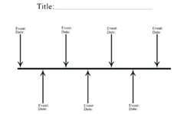
Both groups decide where on the timeline continuum each item should be located. Tape the item face up on the board when you have decided where it should go. You have 15 minutes, you may begin.

Slide 3
ABSTINENT
Abstinence is a self-enforced restraint from indulging in bodily activities that are widely experienced as giving pleasure. Most frequently, the term refers to sexual abstinence, or abstention from alcohol or food

Slide 4
WRITE THE FOLLOWING IN YOUR NOTEBOOK TO BE TURNED IN
1-WHAT IS YOUR ATTITUDE TOWARD ABSTINENCE BOTH POSITIVE AND NEGATIVE.
2-WHY WOULD SOMEONE CHOSE TO BE ABSINENT?
3-WHY DO PEOPLE CHOSE TO HAVE SEX AT A YOUNG AGE?
Student Packet for next lesson

Slide 5
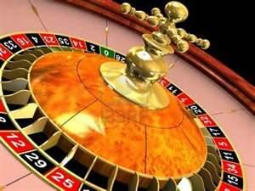
BAG OF BEANS ACTIVITY

Slide 6
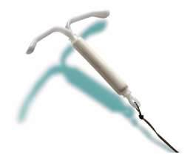
Contraceptive Methods

Slide 7
Abstinence
Implants
Sterilization
Patch or Ring
Pill
IUD
Condom
Diaphragm/Cervical Cap
Spermicidal Foam
Rhythm
Withdrawal

Slide 8
Contraceptive Myth or Fact
Wearing two condoms is better than just one
Having sex standing up will prevent the sperm from swimming up the fallopian tubes
A female cannot get pregnant the first time she has intercourse
Douching, showering or bathing can prevent pregnancy
A female cannot get pregnant if the male pulls out before he ejaculates
Use saran wrap or a balloon if you can’t find a condom
Latex condoms are effective if stored in a wallet or car for months
A virgin cannot get an STI
Condoms decrease sensation and hence reduce pleasure
False
False
False
False
False
False
False
False
False
False

Slide 9
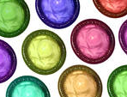
Steps in CONDOM Use
Purchase and check date
Sexual Arousal
Erection
Carefully remove from package
Squeeze out air from tip
Roll condom on
Intercourse
Ejaculation
Hold rim and withdraw
Remove and discard
Loss of erection
Relaxation

Slide 10
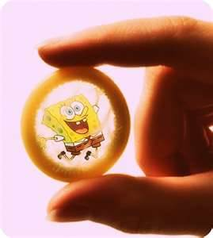
Free Condoms
http://city.milwaukee.gov/nocomdomnoway
Planned Parenthood
School nurse

Slide 11
TRAAP TEST
TIMELY
1-How recent
2-Is it current enough for your topic
RELABILITY
1-What kind of info is included in the resource
2-Is the content fact or opinion
3-Does the creator provide references
AUTHORITY
1-Who is the creator
2-What are their credentials
3-Are they reputable
ACCURACY
1-Where does the info come from
2-Is it supported by evidence
PURPOSE/POINT OF VIEW
1-Is it fact or opinion
2-Is it biased

Slide 12
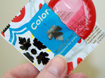
Type: CONDOM
How it works: Prevent semen from entering the vagina
Failure rate: Highest failure rate of all, 18 out of 100 will get pregnant
Protection from STD’s: Decreases HIV risk by 85% if used consistently and correctly. No protection from HPV
Benefits: Easy to obtain
Cost: Packs of three can cost from about $2 to $6

Slide 13
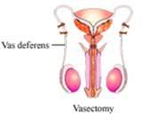
Type: Sterilization
How it works: Male- Vasectomy: clip vas deferens, Female- Tubiligation: clip fallopian tubes
Failure rate:3 in 100 women, almost 100
percent for men
Protection from STD’s: NONE
Benefits: Nothing to remember to take or do
Cost: Women- between $1,500 and $6,000 Men- $350 to $1,000

Slide 14
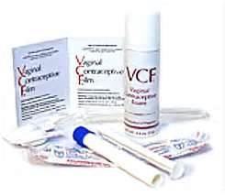
Type: Spermicidal Foam
Description: Foam or jelly used alone or with a cervical cap
How it works: A substance that prevents pregnancy by stopping sperm from moving
Failure rate: Used alone 5 to 59%
Protection from STD’s: NONE, may even lead to increased risk
Benefits: Over the counter
Cost: About $8 per package

Slide 15
Type: Withdrawal - also called coitus interruptus or the "pull out method”
How it works: A man who uses withdrawal will pull his penis out of the vagina before ejaculation
Failure rate: 27/100
Protection from STD’s: NONE
Benefits: All natural
Cost: None

Slide 16
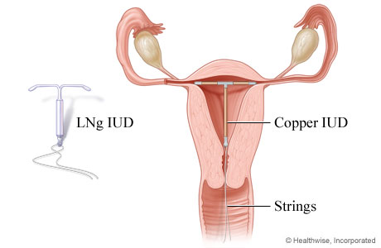
Type: IUDS
Description: 2 inch T-shaped device placed through the cervix into the uterus
How it works: Prevents sperm from reaching the fallopian tube, also prevents the egg from implanting on the wall if it is fertilized.
Failure rate: 1 per 100
Protection from STD’s: NONE
Benefits: Last for years without thought, can be removed if woman wants to get pregnant.
Cost: Between $500 and $1,000 up front, but lasts up to 12 years

Slide 17
Type: Diaphragm
Description: A shallow silicone cup inserted into the vagina to prevent pregnancy
How it works: Diaphragms prevent pregnancy by keeping sperm from joining with an egg. In order to be as effective as possible, the diaphragm must be used with spermicidal cream, gel, or jelly. The spermicide stops sperm from moving
Failure rate: 6 per 100
Protection from STD’s: NONE
Benefits: Using a diaphragm is safe, simple, and convenient
Cost: Diaphragms average from $15 to $75. Spermicide gel, jelly, or cream costs from about $8 to $17 a kit.

Slide 18
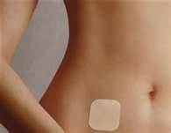
Type: Patch or Ring
Description: Transdermal patch worn on body
How it works: Secretes hormones into the body to prevent pregnancy
Failure rate: 1-2%
Protection from STD’s: NONE
Benefits: No surgery, must change weekly compared to daily for pill
Cost: About $15–$80 a month

Slide 19
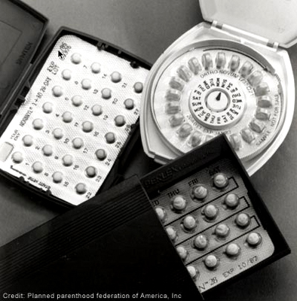
Type: BIRTH CONTROL PILLS
How it works: Prevent ovulation
Failure rate: If taken perfectly, (no missed pills) pregnancy is uncommon- between 3 and 7 a year will get pregnant
Protection from STD’s: NONE
Benefits: Lower the chance of getting ovary and uterus cancer, help with acne, cramps and bleeding during periods.
Cost: About $15–$50 each month

Slide 20
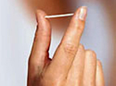
Type: Birth Control Implant (Implanon and Nexplanon)
How it works: Releases a hormone that keeps an egg from leaving the ovaries. It also makes a woman's cervical mucus thicker. This keeps sperm from getting to the eggs.
Failure rate: Less than 1 in 100
Protection from STD’s: NONE
Benefits: Constant BC, don’t have to remember to take anything.
Cost: The cost of the exam, the implant, and insertion ranges from $400–$800. Removal costs between $100 and $300.

Slide 21
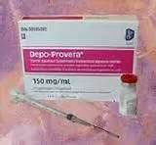
Type: Depo
Description: Injection from a DR into arm or buttocks
How it works: Hormones used to disrupt pregnancy
Failure rate: 1%
Protection from STD’s: None
Benefits: Prevents pregnancy for up to 14 weeks

Slide 22
Type: Natural Family Planning or Fertility Awareness-Based Methods (FAMs)
Description: Charting your fertility to help prevent pregnancy
How it works: To prevent pregnancy, women can abstain from vaginal intercourse on their fertile days.
Failure rate: 24 out of every 100
Protection from STD’s: None
Benefits: They cost very little. They are safe. They can be stopped easily to plan a pregnancy. Calendars, thermometers, and charts are easy to get. Medication is not needed.

Slide 23
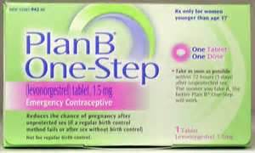
Type: Morning after pill
How it works: Pill taken by the female after sex
Success rate: 89 percent effective when taken within 72 hours (three days) after unprotected sex. Levonogestrel pills may not work as well for women who have a body mass index (BMI) of more than 25.
Protection from STD’s: None
Benefits: Can help to reduce the risk of pregnancy in an emergency
Cost: From $30 to $65

Slide 24
ABC’s of Teen Pregnancy and STI Prevention
A= ABSTINENCE: only 100% effective way to prevent pregnancy and STI infection
B=BE FAITHFUL: You should wait as long as possible to start sexual activity because the earlier you start the more partners you will likely have. More partners means more likely to get an STI
C=USE A CONDOM: If you chose to have sex use a condom. “No” should not be an option, if your partner says that they are not looking out for your well being and this is not the kind of person you should be with

