Slide 1
HGD Survey Instructions
Go to: wellnessandpreventionoffice.org
Click on program surveys in the upper right and click yes
Find Reagan in the third dropdown box (site number is 007), then click I’m a student
Click on pre-survey
Click on Human Growth and Development
Start the survey: site number is 007
Teacher is Toninato
Curriculum is MPS

Slide 2
Human Sexuality
Sexual Behaviors and Attitudes IQ
What is the % of MPS high school students who have had sexual (vaginal) intercourse?
What % of students had sexual intercourse for the first time before the age of 13?
What % of students had sexual intercourse with one or more people during the last 3 months?

Slide 3
Of the students who had sexual intercourse during the last 3 months, what was the % who drank alcohol or used drugs before the last sexual intercourse?
Of students who had sexual intercourse during the past three months, what was the % that used a condom during the last sexual intercourse?
Among students who had sexual intercourse during the last 3 months, what % used birth control pills to prevent pregnancy?

Slide 4
What % of students has ever been taught about AIDS or HIV infection in school?
What % of students have ever given or received oral sex?
What % of high school girls who have had sex wish they would have waited longer to engage in sexual activity?

Slide 5
Answers
1-63.1%
2-12.2%
3-44.0%
4-17.5%
5-66.2%
6-11%
7-85.1%
8-46.8%
9-50%

Slide 6
Who influences your decisions?
Parents/Family
Friends
Media
Church
Your personal values along with education will help you to make responsible in and informed decisions!

Slide 7
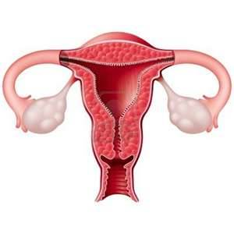
Just the facts
Take your reproduction sheets and walk around the room to each sheet on the wall and fill in the information for both male and female reproduction systems

Slide 8
Male Reproduction System
PURPOSE IS TO PRODUCE SPERM AND GET IT TO AN EGG
Sperm is made in the testes
Sperm is stored in the epididymis
When the male ejaculates sperm is released into the vas deferens
Sperm is mixed with seminal fluid in from the seminal vesicle
Sperm gets more fluid to make semen from the prostate gland
Semen gets a protective fluid from the cowper’s gland
It leaves the body via the urethra
The urethra is inside the penis

Slide 9
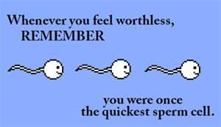
There are 150-300 million sperm released when the male ejaculates. It only takes one to fertilize an egg. Fertilization can happen as fast as 30 minutes.

Slide 10
Female Reproduction System
TO GET THE EGG FERTILIZED AND CARRY THE BABY
Eggs are stored in the ovary
Once a woman begins puberty, once a month an egg matures. During ovulation an egg is released and travels through the fallopian tube
After 5 days in the fallopian tube the egg enters the uterus
If the egg is fertilized it stays in the uterus, if it is not it leaves the uterus through the cervix
The egg exits the body through the vagina

Slide 11
Twins
Fraternal twins-
two separate eggs,
the twins have
separate DNA
Biological twins- one sperm fertilizes one egg, and the egg splits in two, two separate people with the same DNA

Slide 12
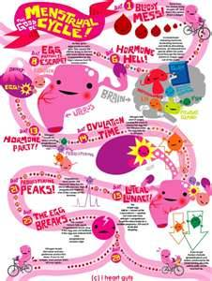
Menstrual cycle
Each female has a unique cycle
It also takes a few years from puberty for the cycle to regulate
Pregnancy, intense exercise and low body fat levels can disrupt the cycle

Slide 13
The cycle
Days 1-4 menstrual flow leaves the body
Days 5-12 estrogen causes the lining of the uterus to thicken and ova in the follicles to mature
Days 13-14 ovulation occurs
Days 15-20 egg travels through the fallopian tubes. This is the most likely place for the egg to be fertilized
Days 21-28 the egg sits in the uterus. If the egg is not fertilized menstruation begins again

Slide 14
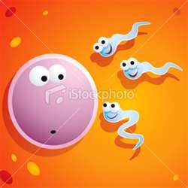
What days are you most likely to get pregnant?
Days 9-16
Sperm can live up to 6 days inside the female
If the sperm enter the fallopian tubes even on day 9 they can still fertilize the egg on day 14 when it is released

Slide 15
Who’s who activity
Place the words into three columns
Female anatomy
Male anatomy
Both

Slide 16
Who's who
PENIS -
URETHRA –
OVARY –
FORESKIN –
FALLOPIAN TUBE –
UTERUS –
BLADDER –
PUBIC BONE –
TESTICLE –
CERVIX –
SCROTUM –
PROSTATE GLAND –
VAGINA –
EPIDIDYMUS -
MALE
BOTH
FEMALE
MALE
FEMALE
FEMALE
BOTH
BOTH
MALE
FEMALE
MALE
MALE
FEMALE
MALE

Slide 17
continued
ANUS –
LABIA –
BREAST –
ENDOMETRIUM –
SEMINAL VESICLE–
VAS DEFERENS –
COWPER’S GLAND-
RECTUM -
BOTH
FEMALE
FEMALE
FEMALE
MALE
MALE
MALE
BOTH

Slide 18
Reproduction and childbirth quiz
Asexual reproduction means there is only one parent T or F
Sperm carry there DNA in the
a. Protozoa b. Flagella c. Head d. tail
______ is the male hormone responsible for sperm to be produced?
a. Flagella b. Testosterone c. Cell
d. Estrogen
Sperm can live only?
a. 10 days b. 20 days c. 40 days d. 60 days

Slide 19
Semen is glandular secretions and sperm together? T or F
The testes are outside of the body to keep the sperm cooler? T or F
Of all the sperm that are ejaculated, how many actually might reach the egg?
a. 1 b. 50 c. 150 d. 200 million
The ovaries are like the testes in the male?
T or F

Slide 20
The female sex hormone is called?
Estrid b. Estrogen c. Dopamean
If sperm don’t get ejaculated what happens to them?
Every ____ days the lining of the uterus sheds unless the woman is pregnant?
a. 15 b. 20 c. 28 d. 35
13. The membrane of the egg prevents more than one sperm from getting in? T or F

Slide 21
Pregnancy lasts
90 days b. 150 days c. 280 days
Pregnancy is broken into
Two halfs b. Three trimesters c. 4 quarters
An embryo becomes a fetus at
a. 8 wks b. 3 months c. 6 months d. conception

