Slide 1
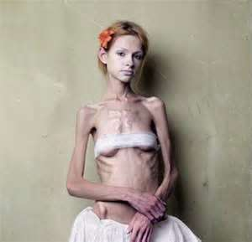
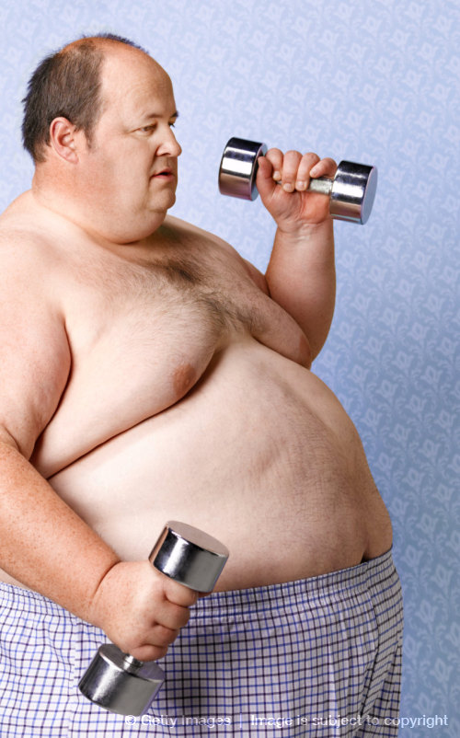
Managing Weight and
Eating Behaviors
Chapter 11

Slide 2
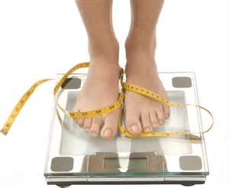
Vocabulary Words
Calories
Metabolism
BMI
Body Image
Weight Cycling
Vegetarian
Dietary Supplements
Performance Enhancers
Herbal Supplements
Mega doses

Slide 3
Calorie connection
There are 3500 calories in a pound
Foods that are high in fat are usually high in calories also, there are 9 calories per gram of fat
There are 4 calories per gram in carbs and protein
Sugary foods contain more calories
Food prep plays a big role in the number of calories in the dish

Slide 4
Portion
Distortion

Slide 5
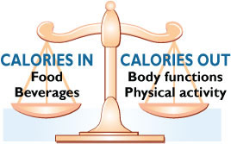
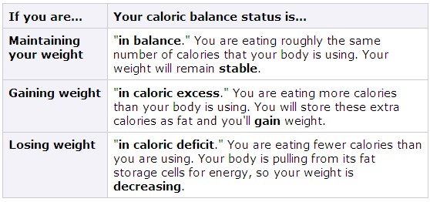

Slide 6
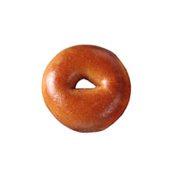
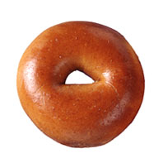
bagel
3 inch diameter
140 calories
5-6 inch diameter
350 calories

Slide 7
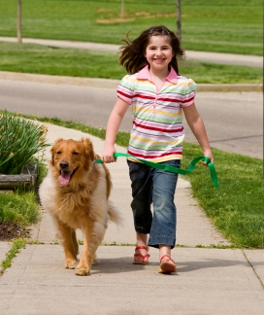
Maintaining a Healthy Weight is a Balancing Act
Calories In = Calories Out
How long will you have to walk the dog in order to burn those extra 210 calories?*
*Based on 160lb person

Slide 8
Calories In = Calories Out
If you walk the dog for 40 minutes, you will burn approximately 210 calories.*

Slide 9
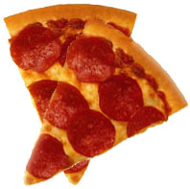
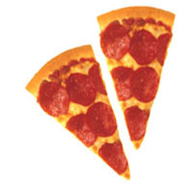
PIZZA
500 calories
850 calories

Slide 10
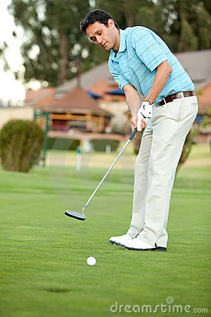
How long would you have to play golf (while walking and carrying your clubs) to burn approximately 350 calories*?
1 hour

Slide 11


Cup of coffee
8 oz
45 calories
16 oz
330 calories

Slide 12

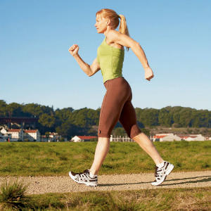
Calories In = Calories Out
How long will you have to walk in order to burn those extra 305 calories?*

Slide 13

Calories In = Calories Out
If you walk 1 hour and 20 minutes, you will burn approximately 305 calories.*

Slide 14


Movie Popcorn
5 cups
270 calories
11 cups
630 calories

Slide 15

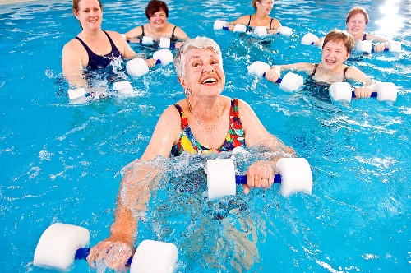

How long would you have to do water aerobics to burn approximately 360 calories*?
1 hour and 10 minutes

Slide 16
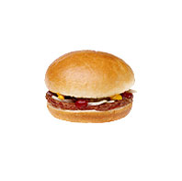
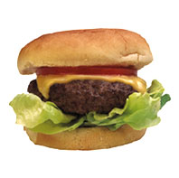
cheeseburgers
333 calories
590 calories

Slide 17
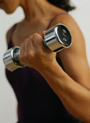
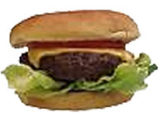
How long would you have
to lift weights to burn approximately 257 calories*?
1 hour and 30 minutes

Slide 18



soda
Original 6.5oz
97 calories
12 oz
145 calories
20 oz
242 calories

Slide 19
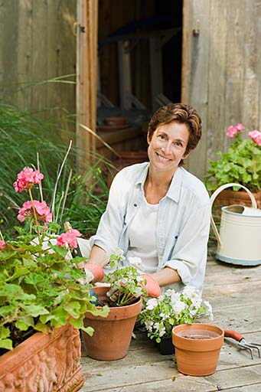
How long would you have to garden to burn approximately
145 calories*?
35 minutes

Slide 20
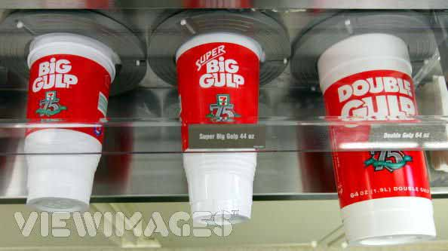
Soda
32 oz
388 calories
44 oz
533 calories
64 oz
776 calories

Slide 21
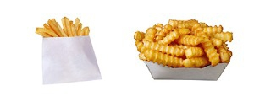
French fries
2.4 oz
210 calories
6.9 oz
610 calories

Slide 22
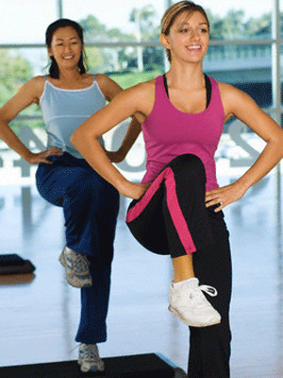
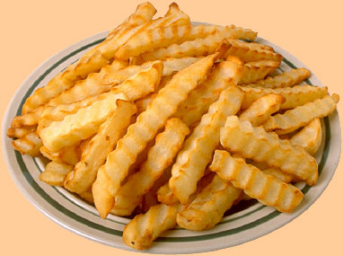
Calories In = Calories Out
How long will you have to do aerobic dance to burn those extra 400 calories?*

Slide 23
Calories In = Calories Out
If you do aerobic dance for 1 hour you will burn approximately 400 calories.*

Slide 24

Blueberry muffin
1.5 oz
210 calories
5 oz
500 calories

Slide 25
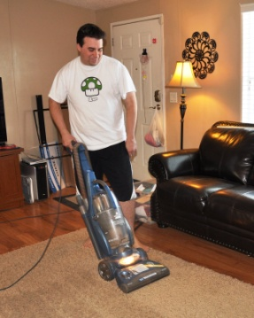
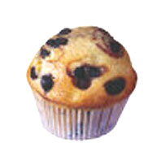
Calories In = Calories Out
How long will you have to vacuum in order to burn those extra 290 calories?*

Slide 26

Calories In = Calories Out
If you vacuum for 1 hour and 30 minutes you will burn approximately 290 calories.*

Slide 27
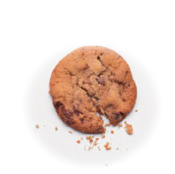
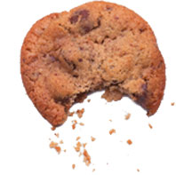
cookie
1.5 in diameter
55 calories
3.5 in diameter
275 calories

Slide 28
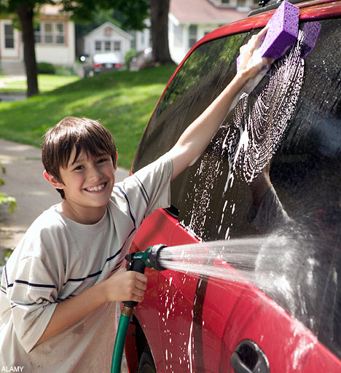
Increased chocolate chip cookie size:
220 MORE calories
How long would you have to wash the car to burn approximately 220 calories*?
1 hour and 15 minutes

Slide 29
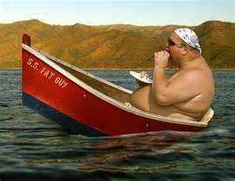
JUST 100 EXTRA CALORIES PER DAY CAN LEAD TO A WEIGHT GAIN OF 10 POUNDS PER YEAR.

Slide 30
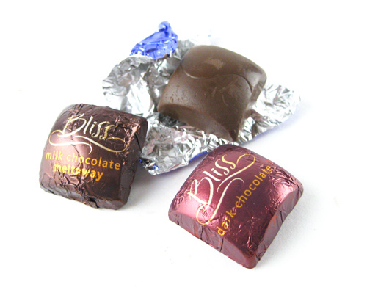
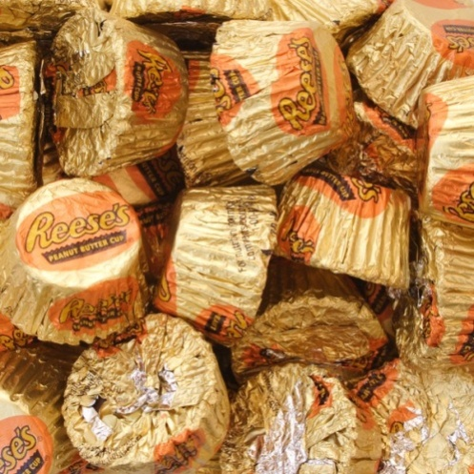
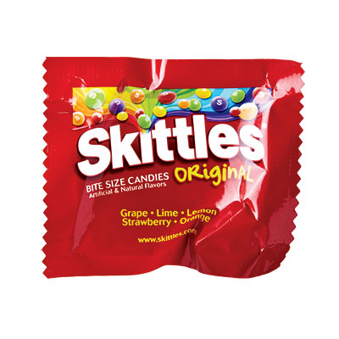
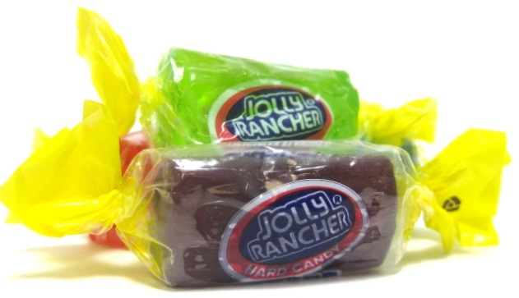
What does that look like?
3 Hershey Bliss Chocolates
2 Reese’s Peanut
Butter Cups Miniature
1 Fun Size Pack of Skittles
4 Jolly Rancher
Hard Candies

Slide 31

Watch out for Portion
Distortion!

Slide 32
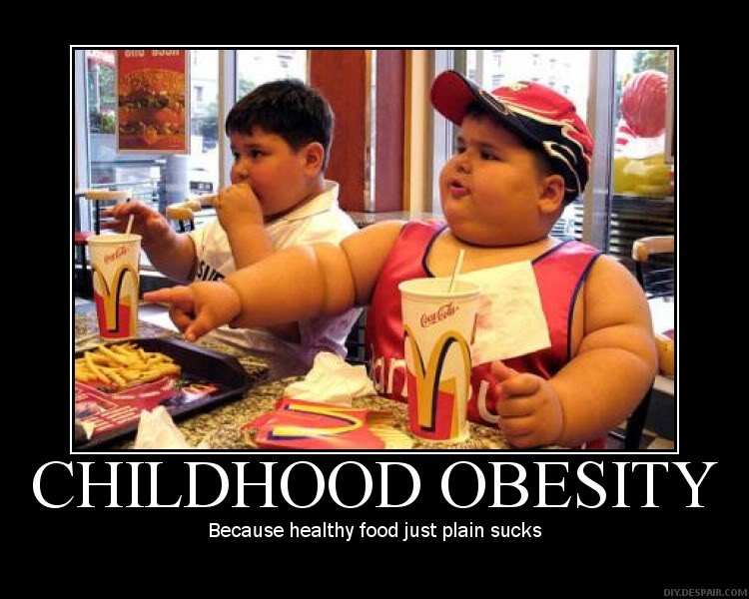

Slide 33
Video: Weight of the Nation
http://theweightofthenation.hbo.com/films/kids-films/the-great-cafeteria-takeover#/watch/kids-films/quiz-ed

Slide 34
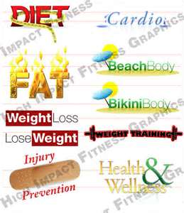
Maintaining a Healthy Weight
Burning what you consume will keep your weight steady
There are several methods to tell you if you are overweight/fat including your BMI
BMI STEPS
1-convert your height to inches
2-divide your weight in pounds by your
height in inches
3-divide the result by your height again,
and multiply the result by 703
4-check out the table on page 293 to see your
range

Slide 35
Healthful Ways to Lose /Gain Weight
Choose nutrient dense foods
Watch your portion size
Eat less high fat/sugar foods
Enjoy your favorite foods in moderation
Be active
Tone your muscles
Stay hydrated
Gaining
                Select foods from the five food groups that are higher in calories
                Eat nutritious snacks
                Exercise so you gain some muscle

Slide 36
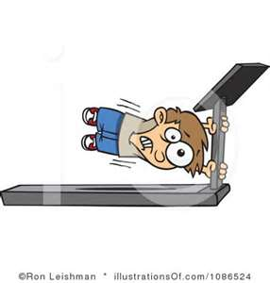
Benefits of Physical Activity
Loss or maintain a healthy weight
Relieves stress
Promotes normal appetite response
It increases self-esteem
Helps you to feel more energetic

Slide 37
Calories Burned During Exercise
Weight lifting
Boxing
Stationary Biking
Running (5.2 mph plus)
Playing catch
Scrubbing floors
XC skiing
Eating
Skateboarding
395
692
501
593
165
362
718
99
330

Slide 38

Body Image and Eating Disorders
Where does body image come from???
Teens are going through many rapid growth spurts so just accept yourself
Fad Diets- usually not so healthy and don’t tend to work
Eating Disorders include:
    Anorexia
    Bulimia
    Binge eating
    EDNOS

Slide 39
Lifelong Nutrition
Several factors that affect your nutritional needs
Age-teens need more calories
Gender-Females need fewer calories, but more nutrients like iron and calcium
Activity level-more active = more calories

Slide 40
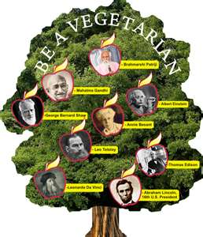
Vegetarian Diets
Lacto-ovo eat dairy and eggs
Lacto-dairy
Ovo-eggs
Vegan
Drawbacks are that plant based foods tend to be lower in certain nutrients

Slide 41
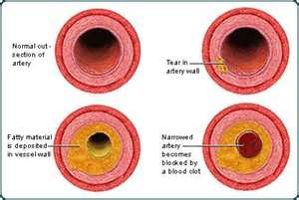
Common Health Conditions and Food
Diabetes-must monitor carbs and sugars
Food Allergies
Lactose Intolerance
Celiac Disease (gluten intolerance)
High Blood Pressure
High Cholesterol

Slide 42
Performance Enhancers
Anabolic Steroids- illegal, many health risks
Creatine- improves muscle performance
Energy drinks- high amounts of caffeine, greatly increases heart rate, dehydration

Slide 43
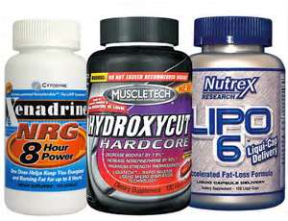
Using Supplements'
Herbal- all natural plant extracts
are not regulated by gov
Mega doses- can cause a build up which can become a problem. A, D, E, and K can become toxic
Supplements are no substitute for good eating

